Slide 1
WELCOME
CONTACT FORM

Slide 2
OBJECTIVE
To design and develop a Contact Form webpage using HTML and CSS.
To allow users to submit their contact details and messages.
To create a simple and user-friendly interface for communication.
To improve skills in form creation and web page styling.

Slide 3
TOOLS USED
HTML- To create the structure of the restaurant menu
CSS- To style and design the menu page
VISUAL STUDIO CODE- Code editor used for development
WEB BROWSER- To test and view the webpage

Slide 4
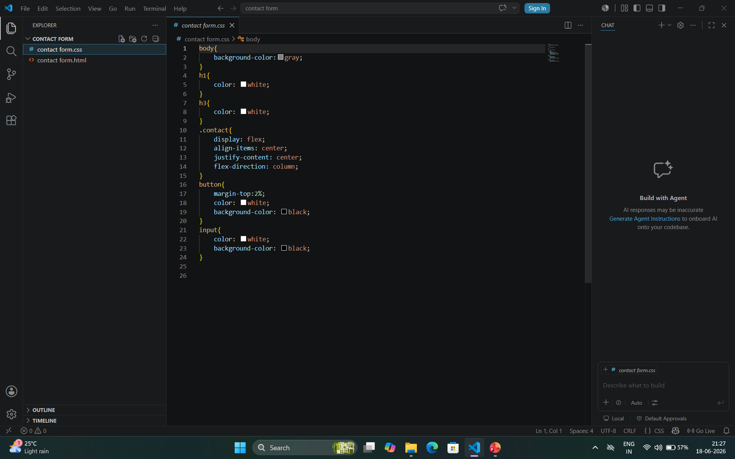
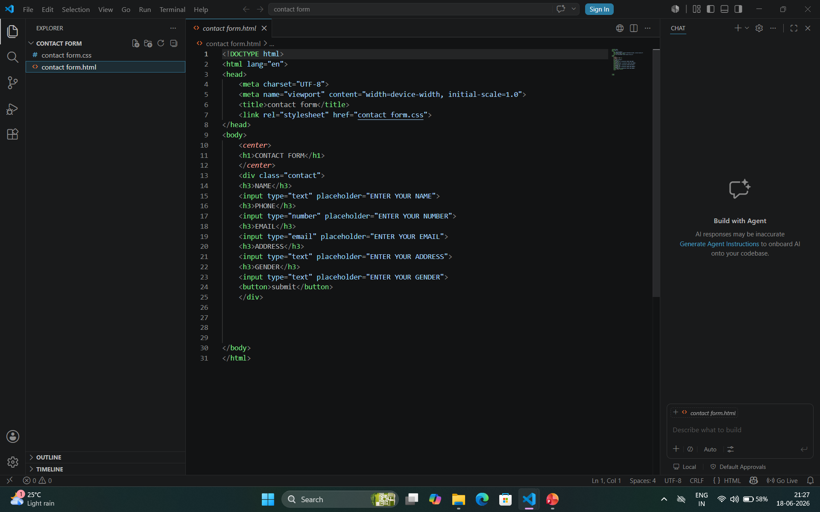
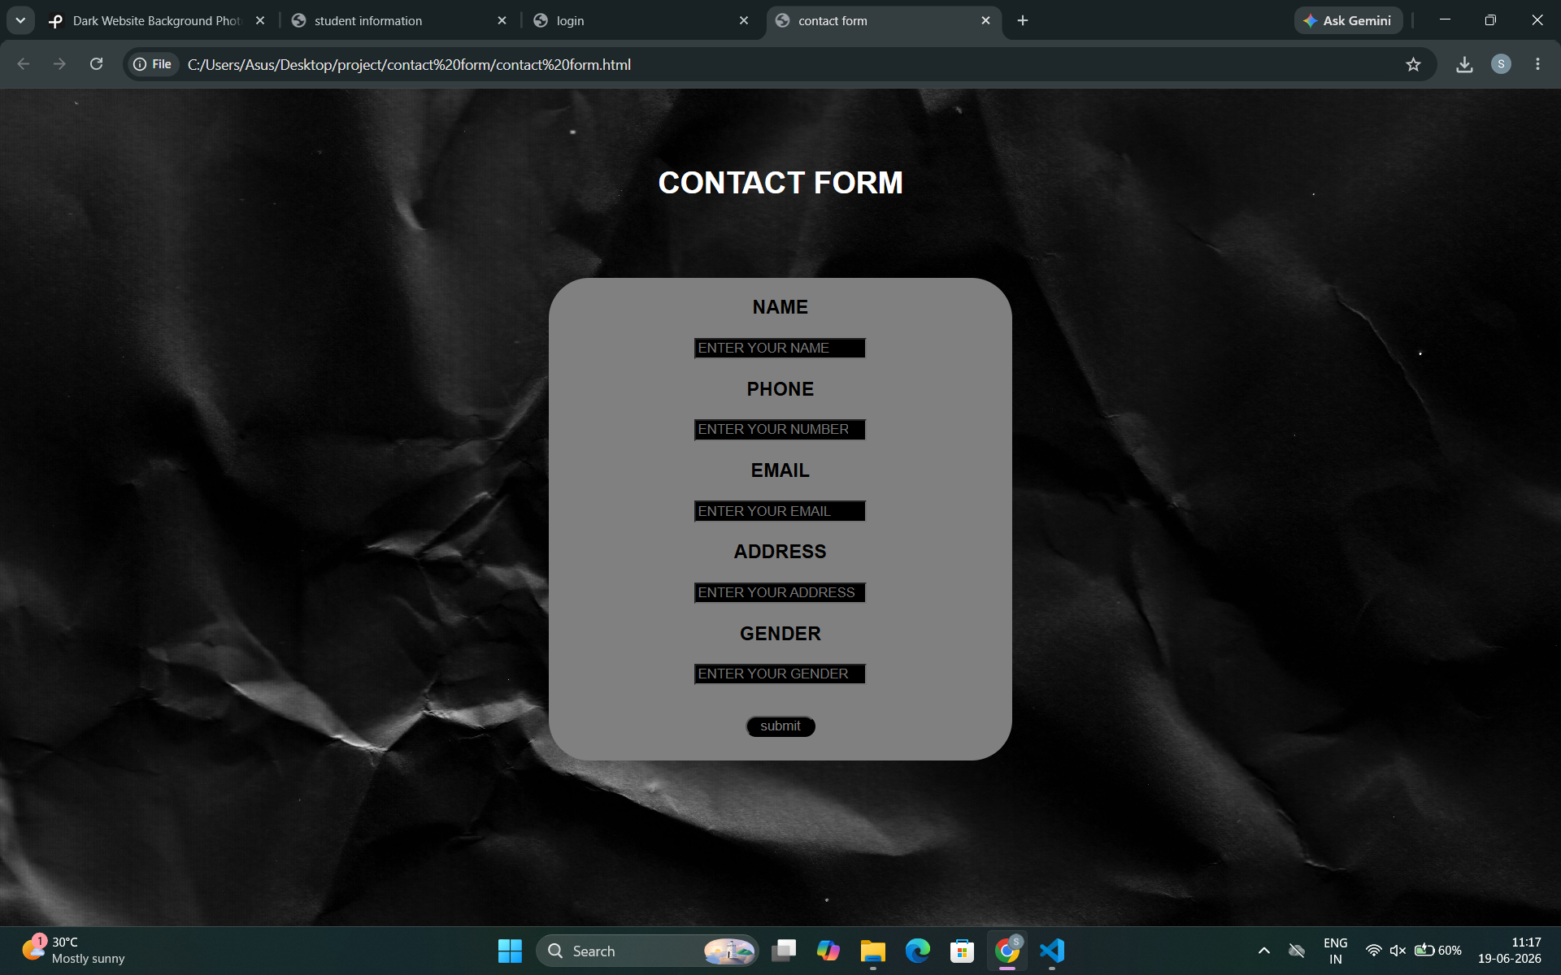
SCREEN SHOTS

Slide 5
THANKYOU

